Slide 1
5G Network Slicing Security
Network Security (2021-2022)
COctavian

Slide 2
Summary
What is Network Slicing?
Network Slicing Arhitecture
Network Slicing Security Benefits
Bibliography

Slide 3
What is Network Slicing?
5G network slicing is a network architecture that enables the multiplexing of virtualized and independent logical networks on the same physical network infrastructure. Each network slice is an isolated end-to-end network tailored to fulfil diverse requirements requested by a particular application.

Slide 4
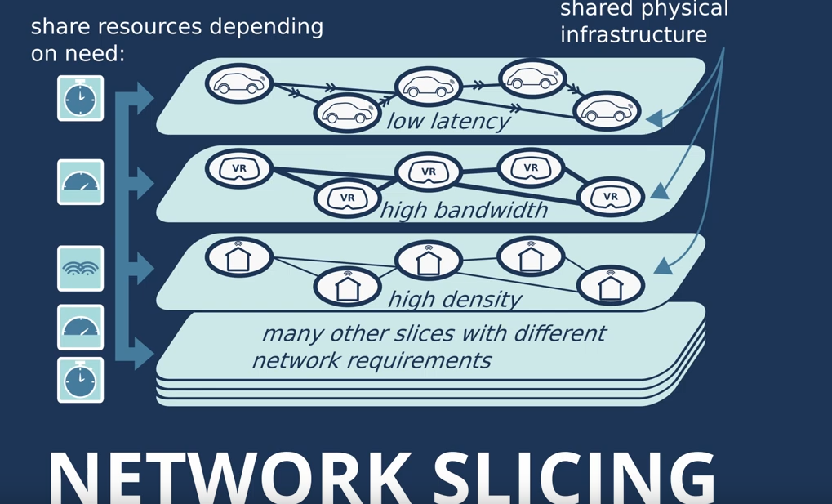

Slide 5
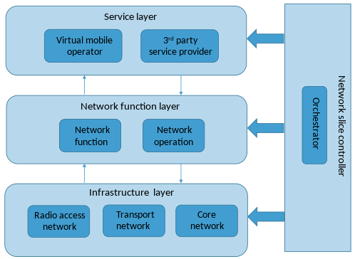
Network Slicing Arhitecture

Slide 6
Network Slicing Security Benefits
Isolating resources and control, in addition to user traffic, is important to protect critical systems from denial-of-service attacks and fault occurrences as only the target slice is affected.
With 5G network slicing, locating devices with similar behavior and characteristics on the same slice makes it easier to baseline typical behavior and detect anomalies or unexpected changes in traffic patterns. A device whose traffic falls outside regular traffic patterns can trigger a warning or be moved to a quarantine slice, either for deeper analysis or to enable it to continue to operate but under tighter restrictions.

Slide 7
Bibliography
https://en.wikipedia.org/wiki/5G_network_slicing
https://www.youtube.com/watch?v=dCt3rYODZ7g
https://www.techtarget.com/searchsecurity/tip/5G-network-slicing-security-benefits-IoT-mobile

Slide 8
Thank you for attention! :D

